Slide 1
Constants
Part 1
Creative Commons Attribution-NonCommercial-ShareAlike 3.0 Unported License. http://creativecommons.org/licenses/by-nc-sa/3.0/
Written by Rachel J. Morris, last updated 2015-01-14

Slide 2


Const Variables
The const keyword allows us to declare variables that cannot be changed after they are initially assigned.
A variable that is declared as const must be initialized to some value.
“while not done”

Slide 3
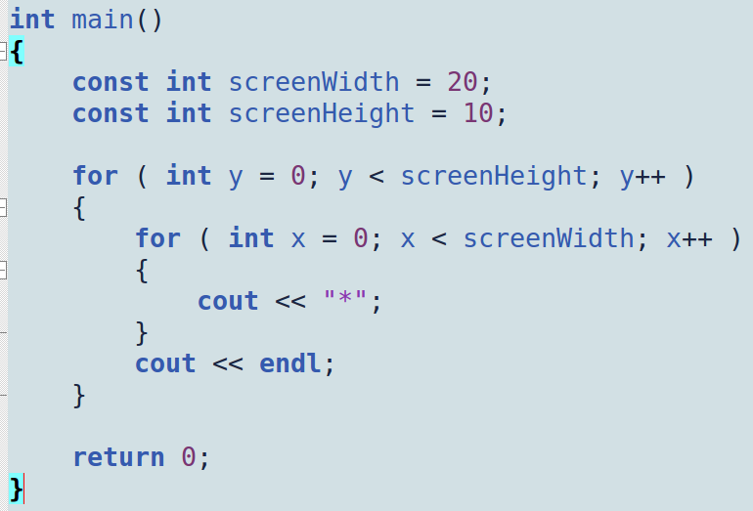
Const Variables
Using const is a good way to avoid hard-coding numeric values in your program.
By declaring a const variable, you give that number a label – a name – so that your code is more clear.
“while not done”

Slide 4
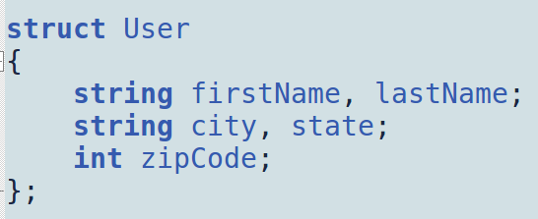
Const with Pass-By-Reference
Const is also useful with pass-by-reference parameters.
Sometimes, you want to pass an argument by reference not because you want to change its value, but because it would be costly to copy it, such as when passing-by-value.
“while not done”
Non-primitive objects, such as strings or classes / structures defined by the user, are potentially costly to copy.

Slide 5
Const with Pass-By-Reference
Const is also useful when pass-by-reference parameters.
When making a copy of a big list of Users, every internal member of the User class/struct must also be copied.
A string is not a primitive type – it is also a class with its own members and functions.
“while not done”

Slide 6
Const with Pass-By-Reference
Instead of passing the argument as a
pass-by-value, instead we can
pass-by-reference, but add the const
keyword to ensure that the argument
will not be changed.
“while not done”
It is good practice to make a habit of passing any objects as const references
(when you need the value to not change).

Slide 7
Other uses of Const
We will revisit const when we cover classes, as it can also help protect the members of a class, by marking an object's functions const.
Const can also come in handy when dealing with pointers and functions.
More on that later, too...

